Slide 2


What is Microsoft Bicep?

Slide 3
https://bit.ly/3rXkzAP

Slide 4
Introduction to project Bicep
Why did Microsoft build Bicep when we already have ARM templates?
ARM templates can be difficult to manage they are complex and lengthy
The Bicep language is stored in files with the extension .bicep
The Bicep engine transforms the code between Bicep and JSON

Slide 5
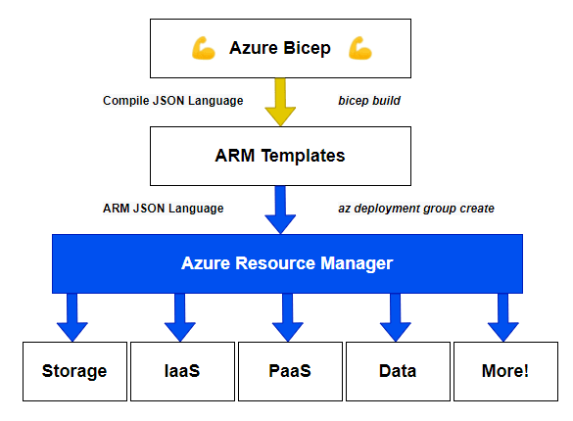

Slide 6
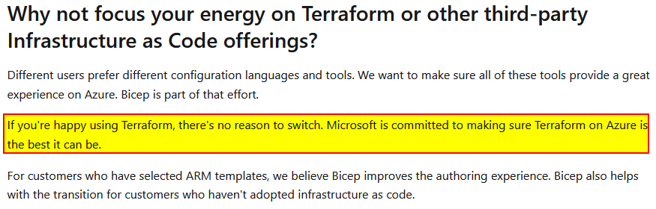
Terraform vs. Bicep
Terraform is always behind new products/features in Azure
Terraform uses something called state files.
Bicep uses modes “incremental” or “complete”
If you already are using Terraform, should you switch?

Slide 7
HANDS-ON LAB

Slide 8
Requirements
You must have an Azure subscription available
Running Windows 10 or 11
Have installed VS Code

Slide 9
What about resources established outside Bicep?

